Slide 1
Microsoft Movie Analysis
Investing in The Big Screen

Slide 2
The Purpose
Provide actionable insights for profitability that a company like Microsoft could use to venture into the movie industry.

Slide 3
Considerations Before Investing
Segmenting audience with language preferences.
Release Month.
Gross value.
Demography of its target audience.
Customer satisfaction.

Slide 4
Outline:
Data Used
Analysis of Data
Observations
Recommendations

Slide 5
Data Used:
Box Office Mojo Movie data.
Bom movie gross
Final Dataset Used:
Internet Movie Database data.
Imdb title basics.
The Movie Database.
Tmdb movies

Slide 6
Strategy for Analysis
Perform Exploratory Data Analysis to maximize the insights into data .
Generate summary statistics for numerical data.
Create graphical visualizations to understand the data better

Slide 7
Observations:

Slide 8
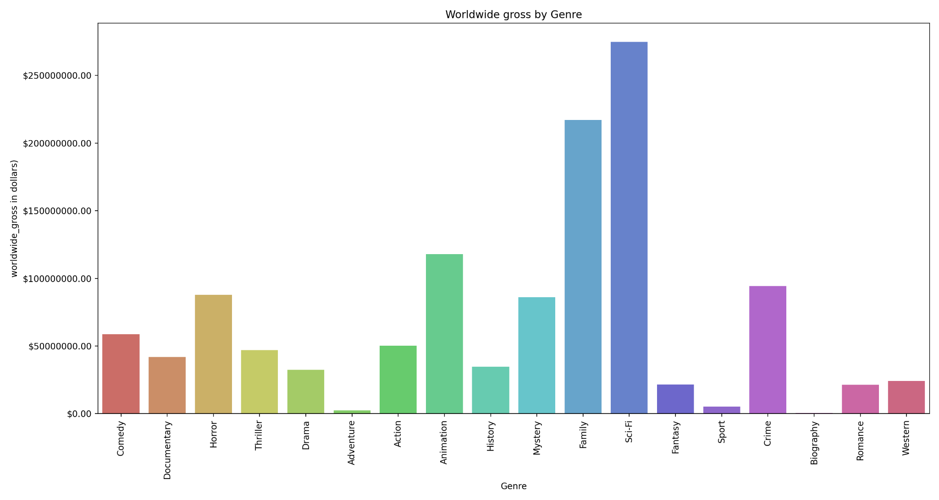
Observation 1:
Genre generating the highest worldwide gross:

Slide 9
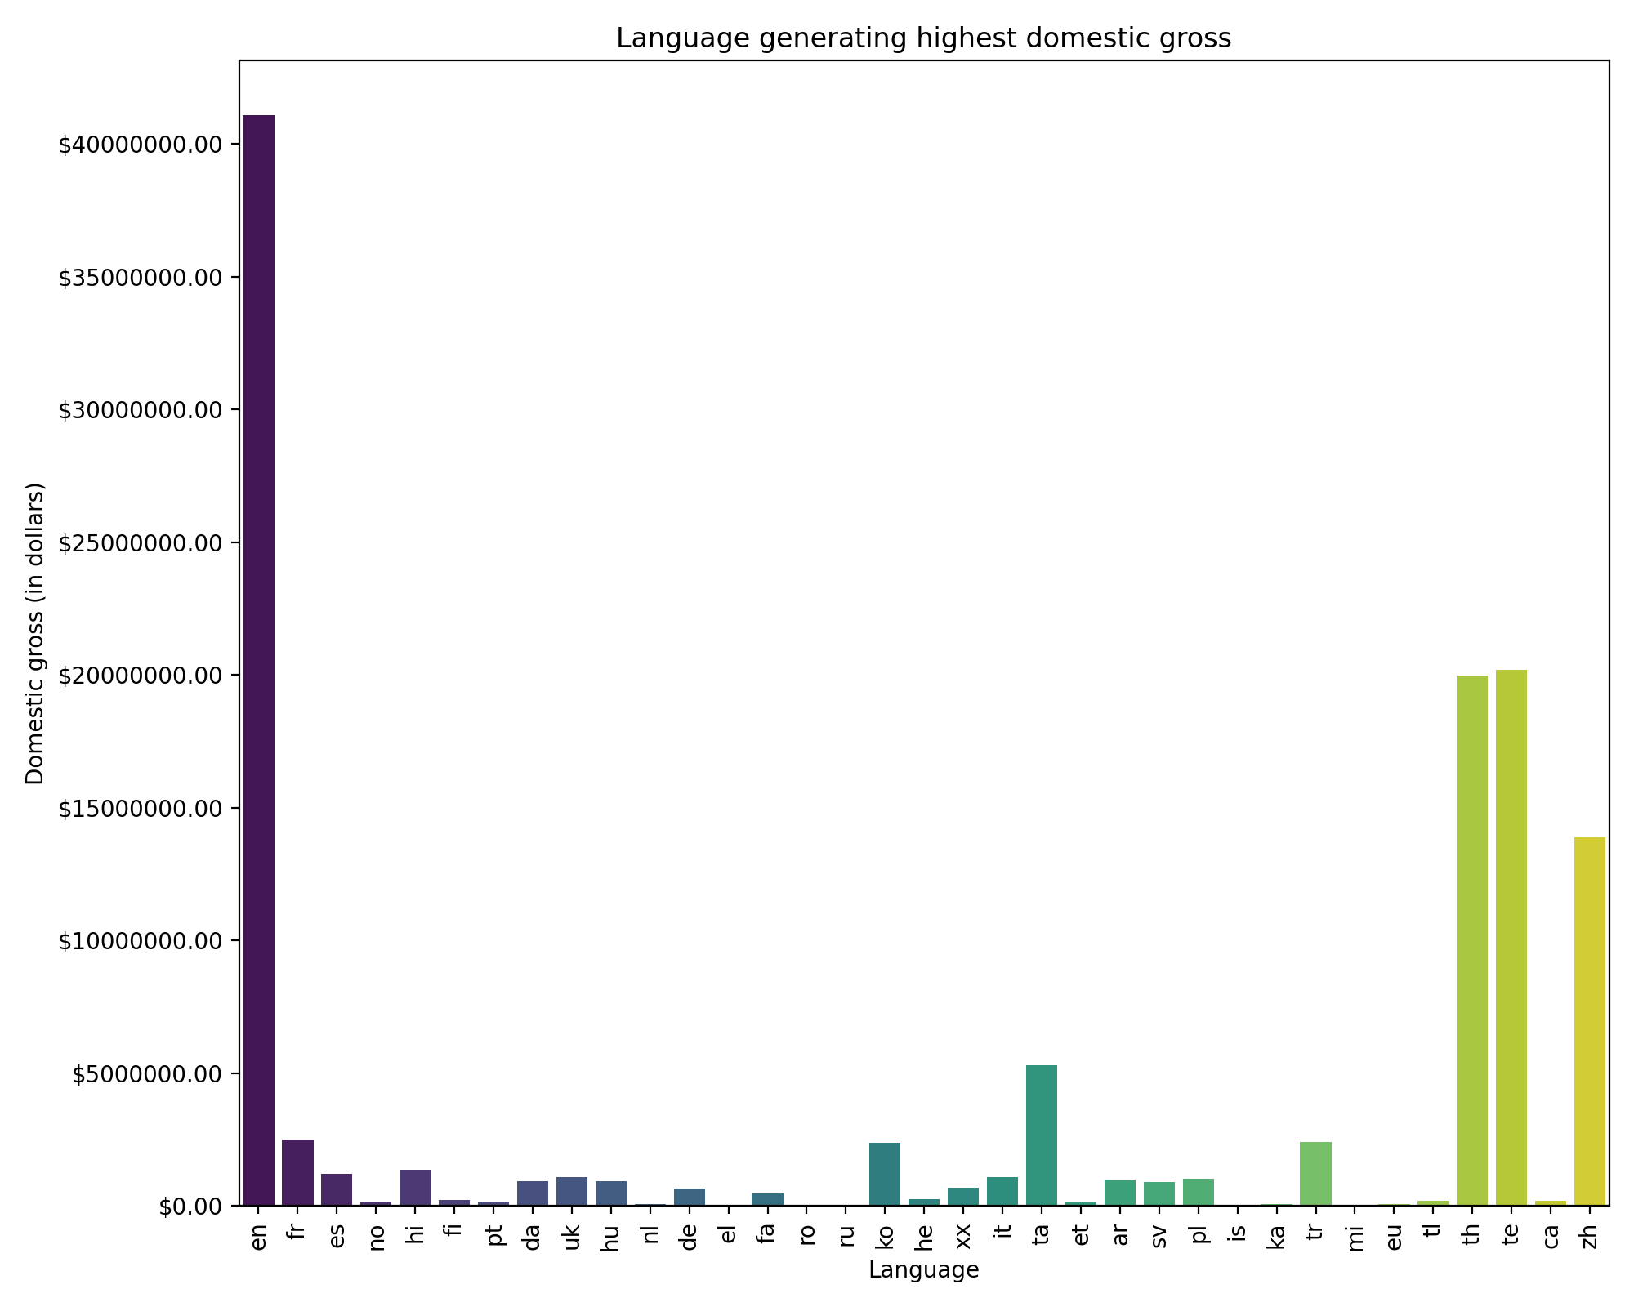
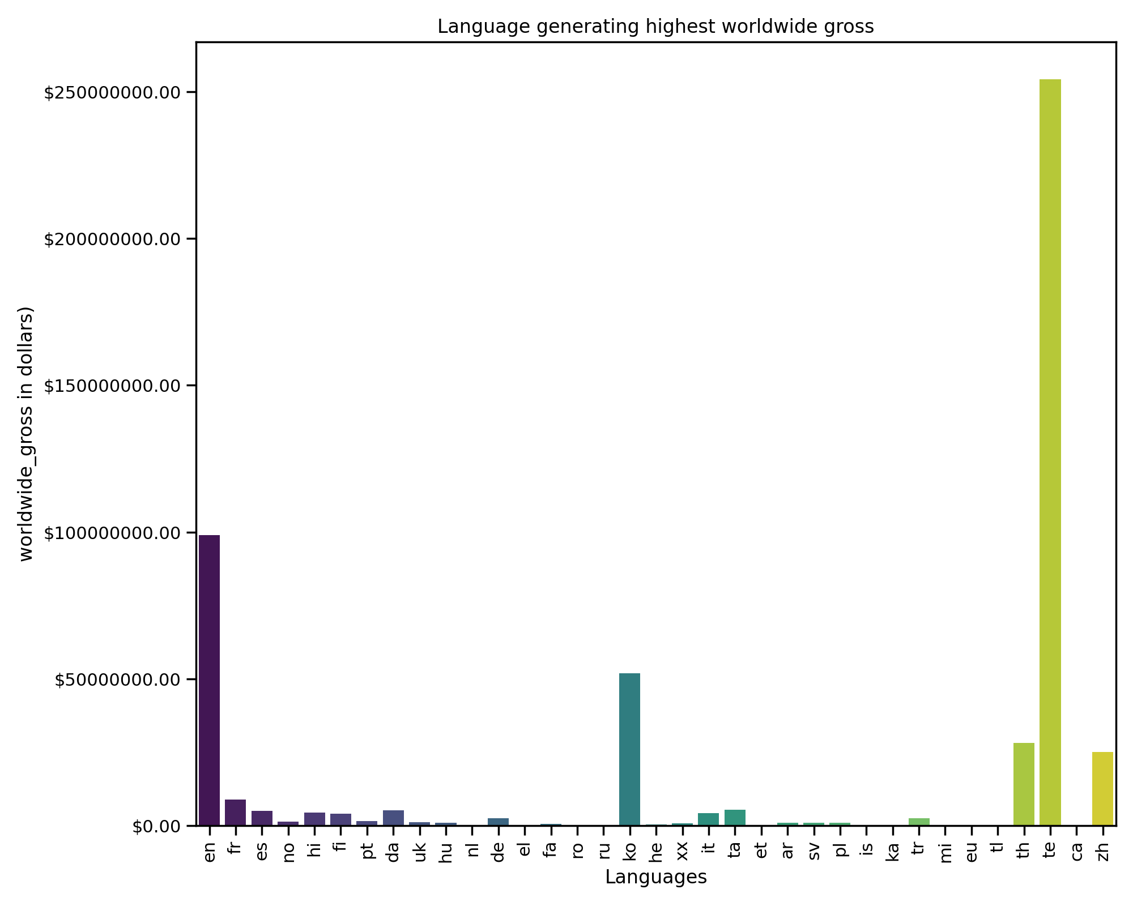
Observation 2:
Language generating the Highest Worldwide Gross:
Language generating the Highest Domestic Gross:

Slide 10
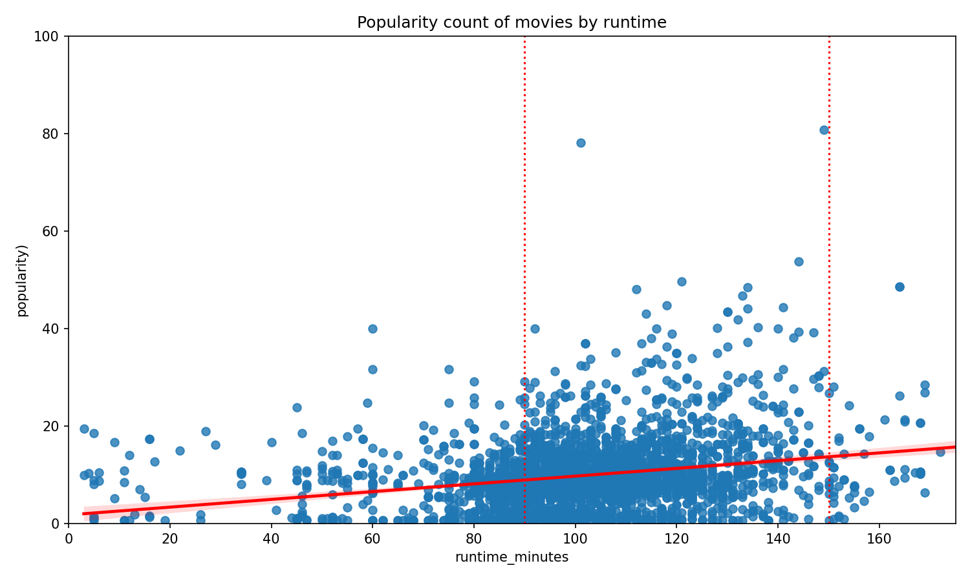
Observation 3:
Correlation between runtime & popularity count.

Slide 11
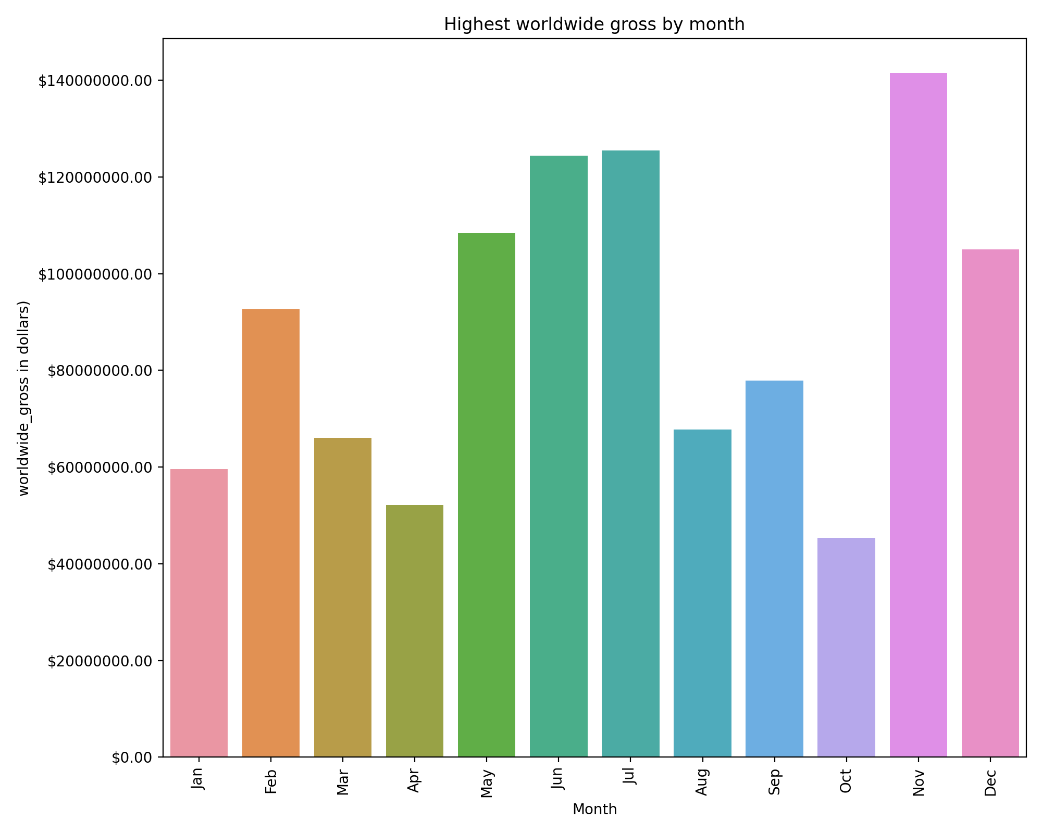
Observation 4:
Release Month that gathers the highest Worldwide Gross.

Slide 12
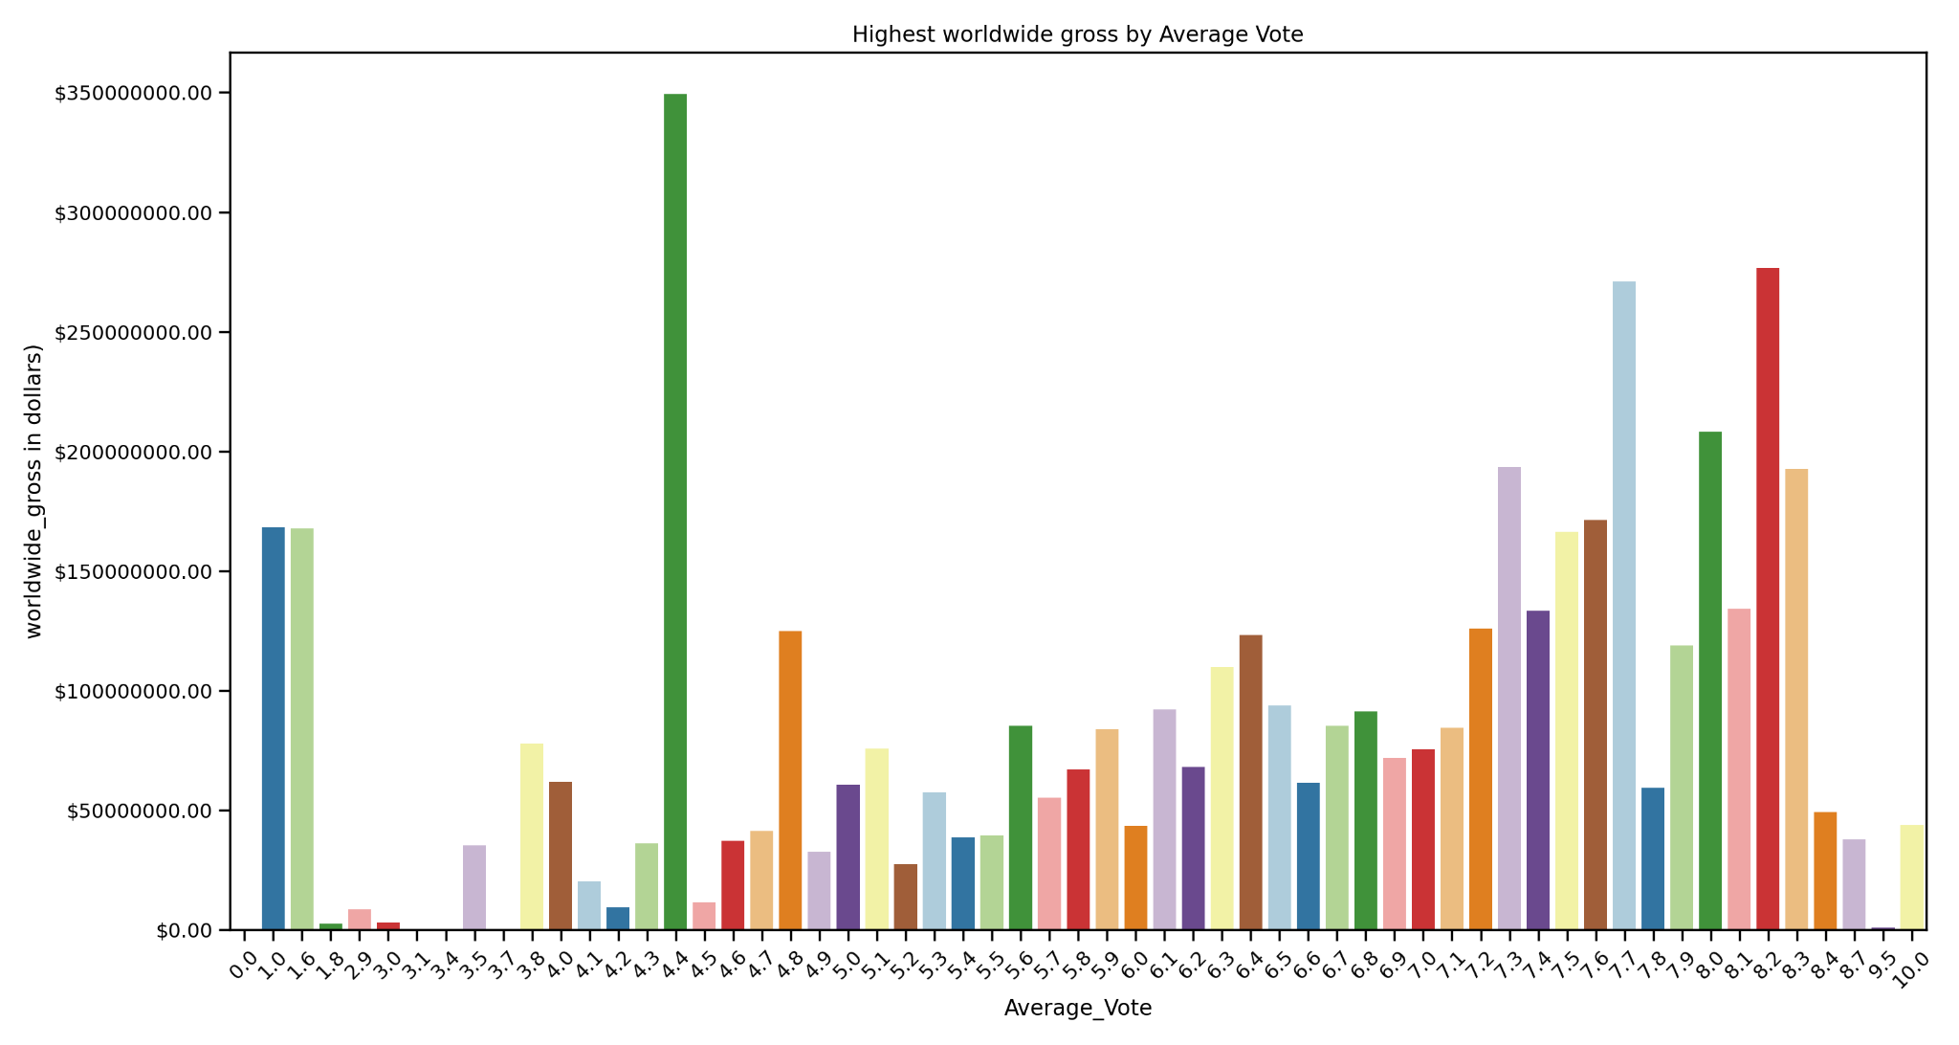
Observation 5:
Average_vote that generates highest Worldwide
Gross

Slide 13
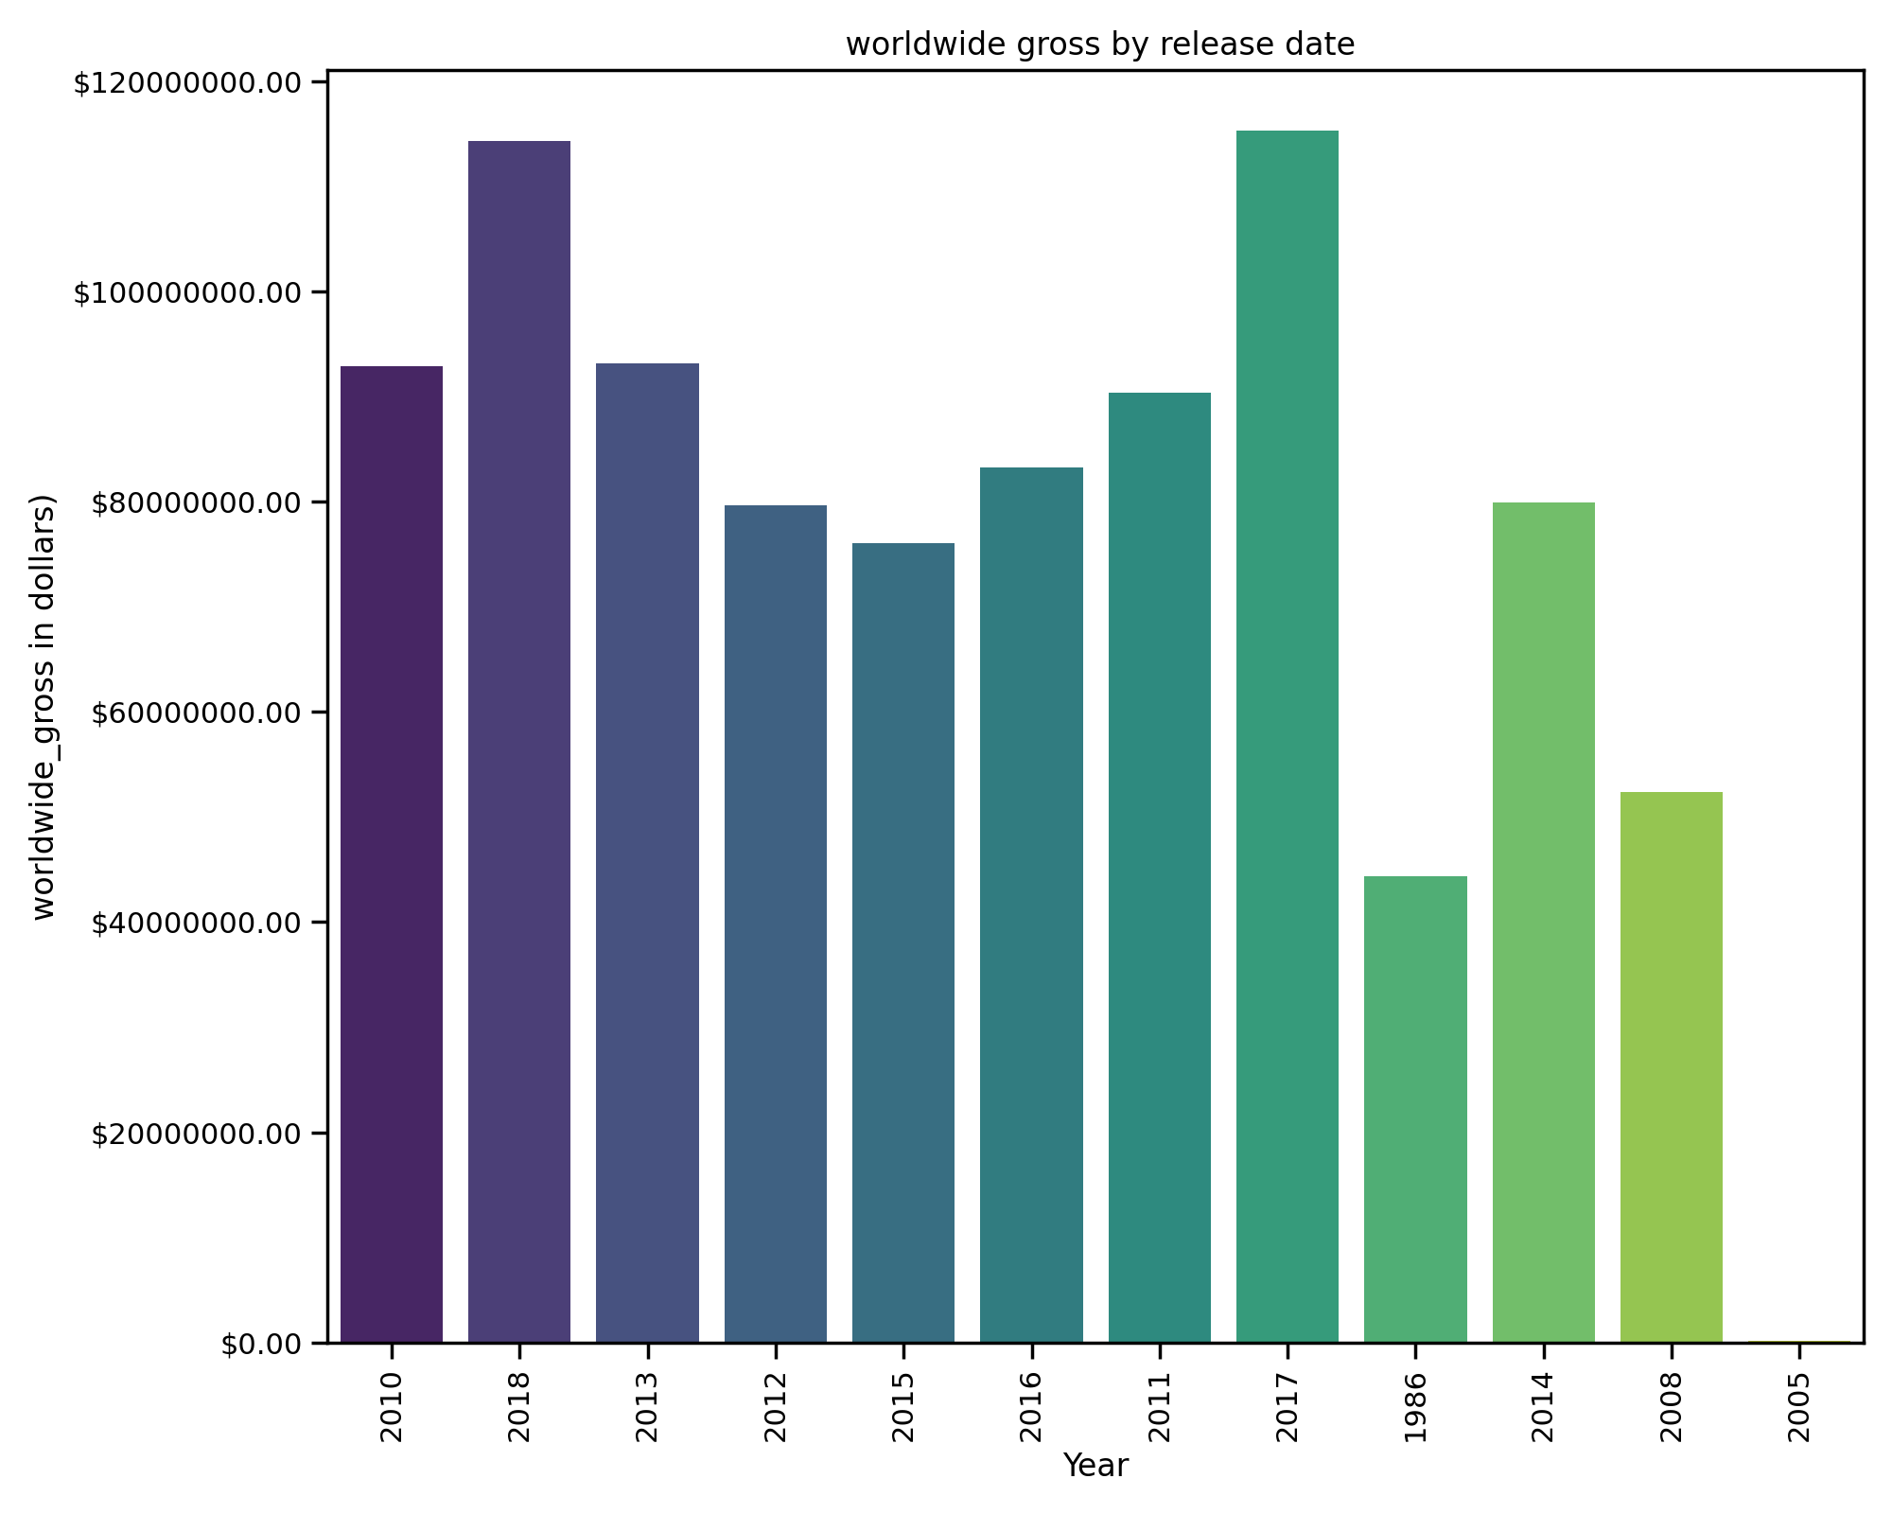
Observation 6:
Most profitable year for the business.

Slide 14
Findings
Movie Genre: Sci Fi
Preferred Language:
Worldwide: Telugu
Domestic: English
Popularity with Runtime:
Positive Correlation within a time frame.
Release Month
Average Vote Count matters.

Slide 15
Recommendations
Focus on Movie Genre.
Runtime should not be overlooked.
Movies with Average vote count seems to be doing well.
Release Time of Movie is important.
Knowing language preferred by your audiences matters.

Slide 16
THANK YOU
Namita Rana
Email:namitarana21@gmail.com
Github:https://github.com/namitarana1

